Slide 1
Exploring GAN
Machine Learning and Data Mining
Anton Zaitsev – Othmane Mahfoud

Slide 2
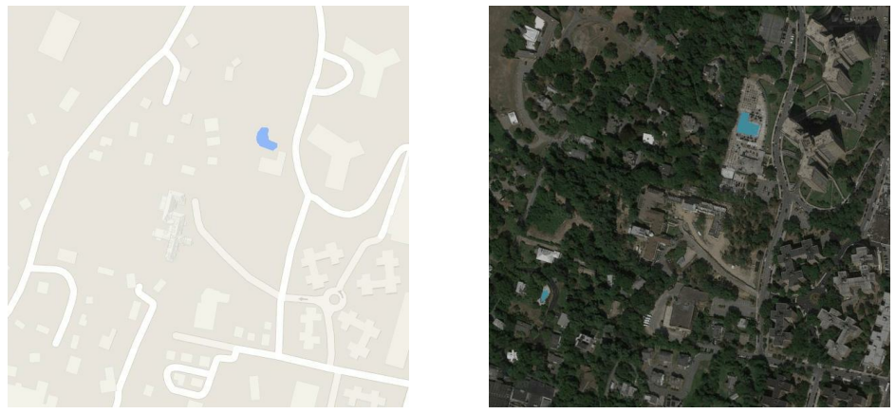
Overall Task

Slide 3
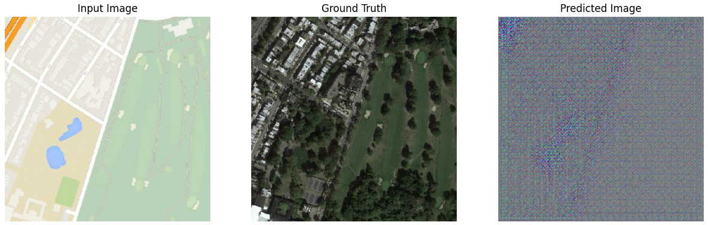
Task for the Generator

Slide 4
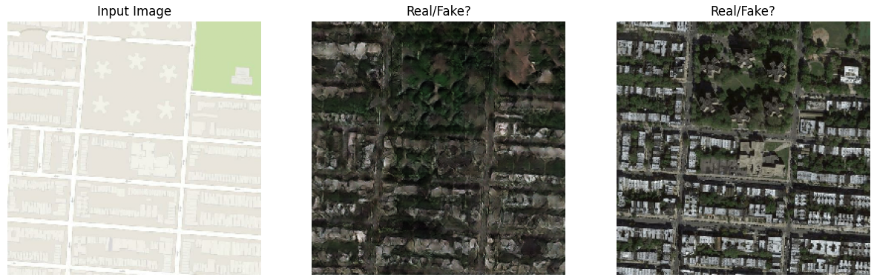
Task for the Discriminator
Hmmm… not real!
Hmmm… looks real!

Slide 5
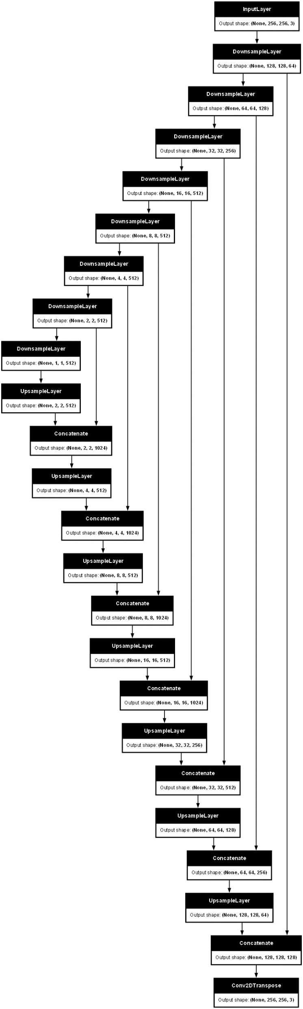
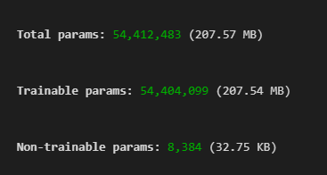
GAN Architecture (Generator)
SKIP CONNECTIONS
UPSAMPLE
DOWNSAMPLE
COMPRESSED (1x1x512) REPRESENTATION OF IMAGE

Slide 6
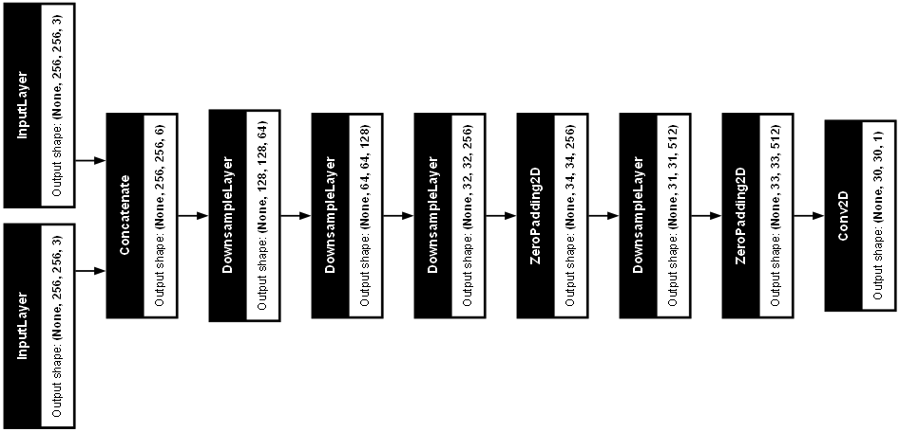
GAN Architecture (Discriminator)
PROBABILITIES (from 0 to 1) OF BEING REAL
REAL IMAGE
GENERATOR (FAKE) IMAGE

Slide 7
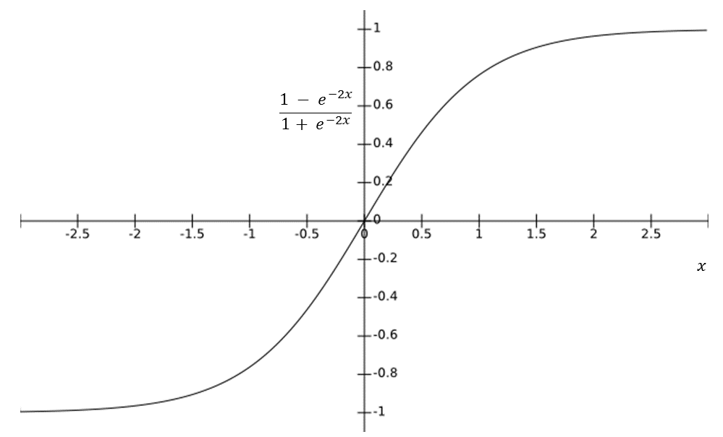
Generator
Why use Tanh activation in the Generator last layer?
We normalize the images from -1 to 1.
Generator loss
gan_loss: calculates the Binary Crossentropy loss between the discriminator's output and a tensor of ones. the generator wants the discriminator's output to be close to 1 (believing the image is real), the loss becomes smaller as the discriminator's output gets closer to 1.
L1_loss: MAE - encourages the generated image to resemble the target image in terms of pixel values; LAMBDA - weight of the MAE compared to the Binary Crossentropy loss.
total_gen_loss = weighted sum of two losses.

Slide 8
Discriminator
Why no activation function?
We use BinaryCrossentropy with from_logits=True. This function is specifically designed to work with logits (unnormalized outputs) from the discriminator.
Discriminator loss:
real_loss: the loss function wants this value to be close to 1 (real), we compare the output of the discriminator for the real image with ones. (tf.ones_like)
generated_loss: same thing, but want this to be close to 0 (fake), since compare with generator image (tf.zeros_like)
total_loss = weighted sum of two losses (notice no weights here).

Slide 9
Training
During training, we use separate gradient tapes for the generator and discrimator, which allows to calculate the gradients for each network's loss function separately within the with tf.GradientTape() block.
Gradient tape is a tool in TensorFlow for performing automatic differentiation.

Slide 10
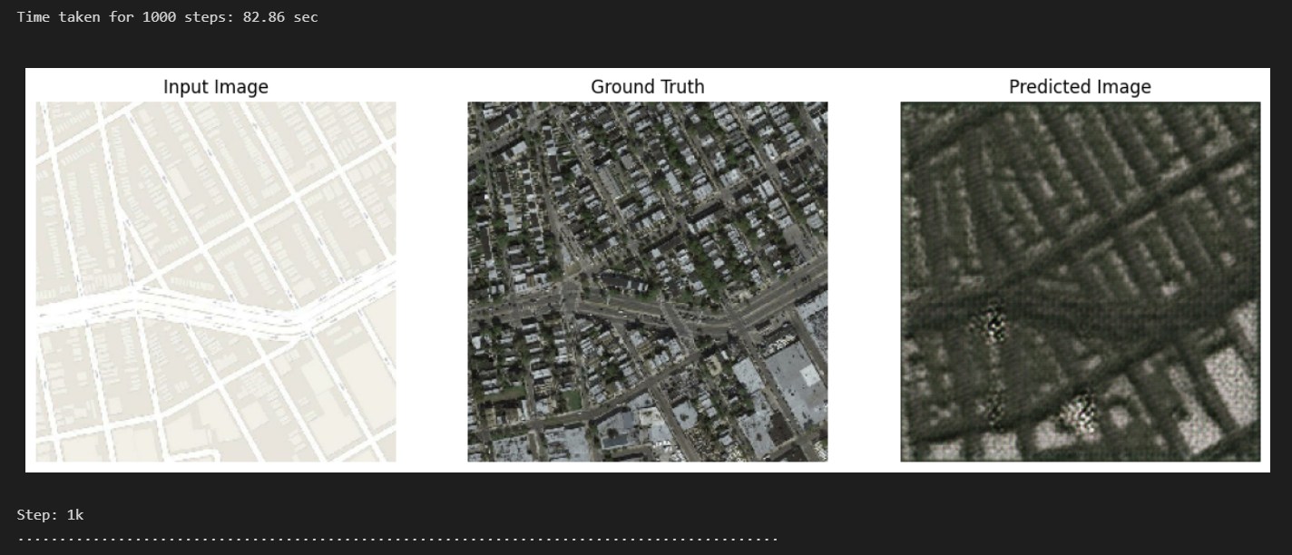
Training

Slide 11
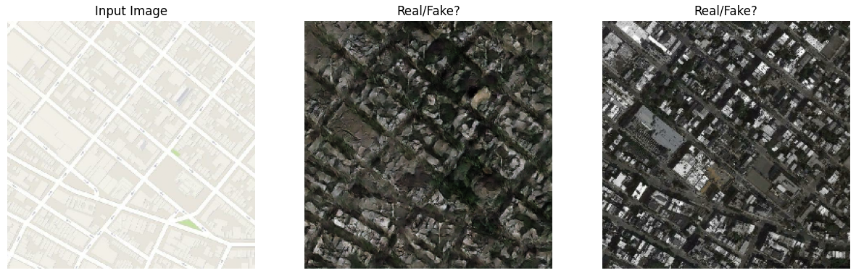
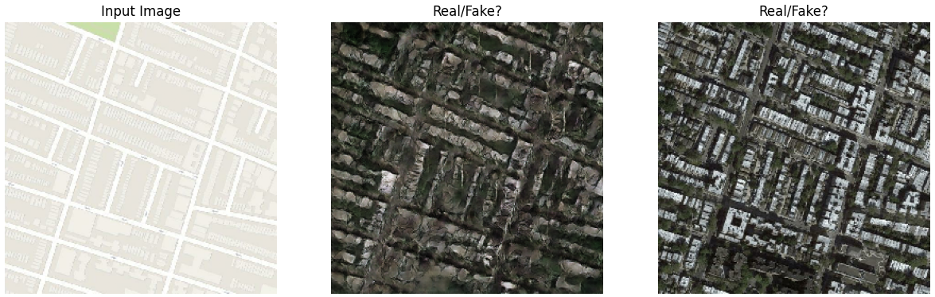
Training – After 40K Steps

Slide 12
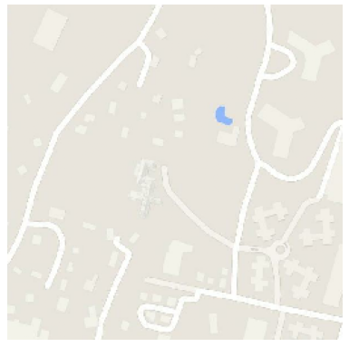
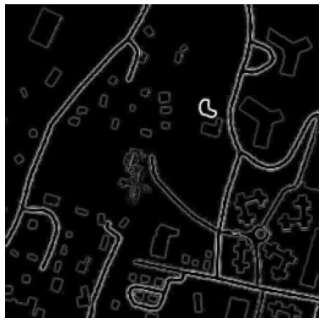
Introducing Edge Map
Terrain
Edges Map of the Terrain Image

Slide 13
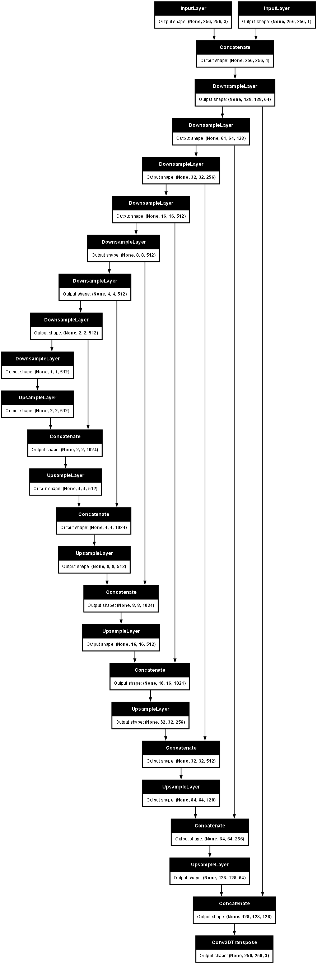
GAN Architecture (Generator) | Edge Map
EDGES
SKIP CONNECTIONS
UPSAMPLE
DOWNSAMPLE
COMPRESSED (1x1x512) REPRESENTATION OF IMAGE

Slide 14
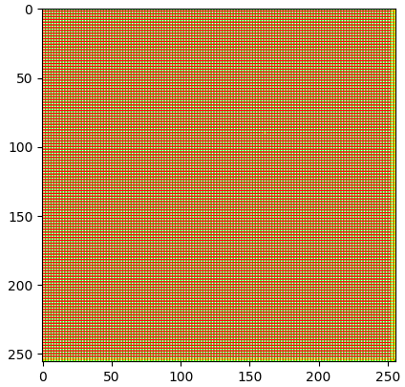
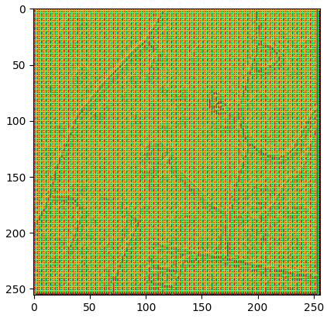
Introducing Edge Detection | Generator
Generator Prediction w/o Edges
Generator Prediction w/ Edges

Slide 15
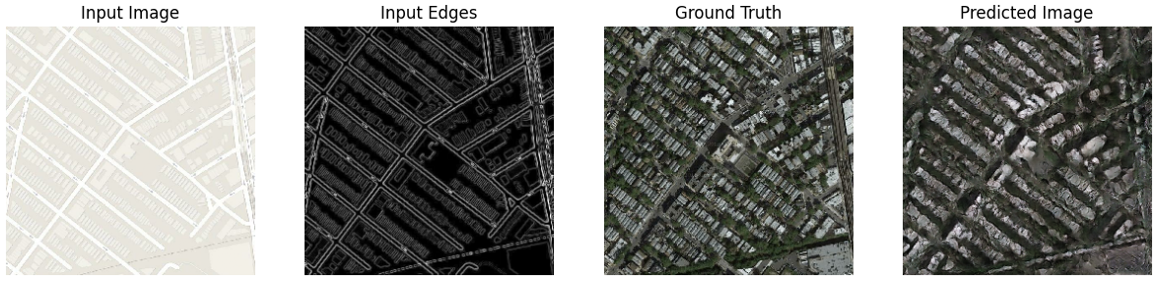
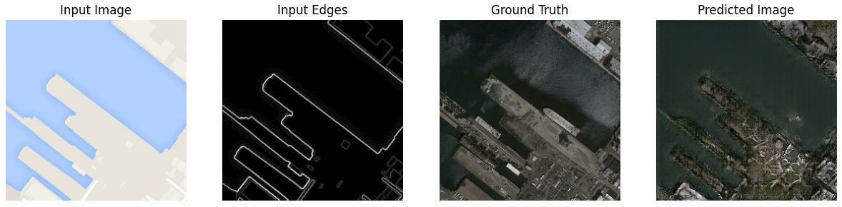
Training – After 40K Steps | Edge Map

Slide 16
Training – After 40K Steps | Blur

Slide 17
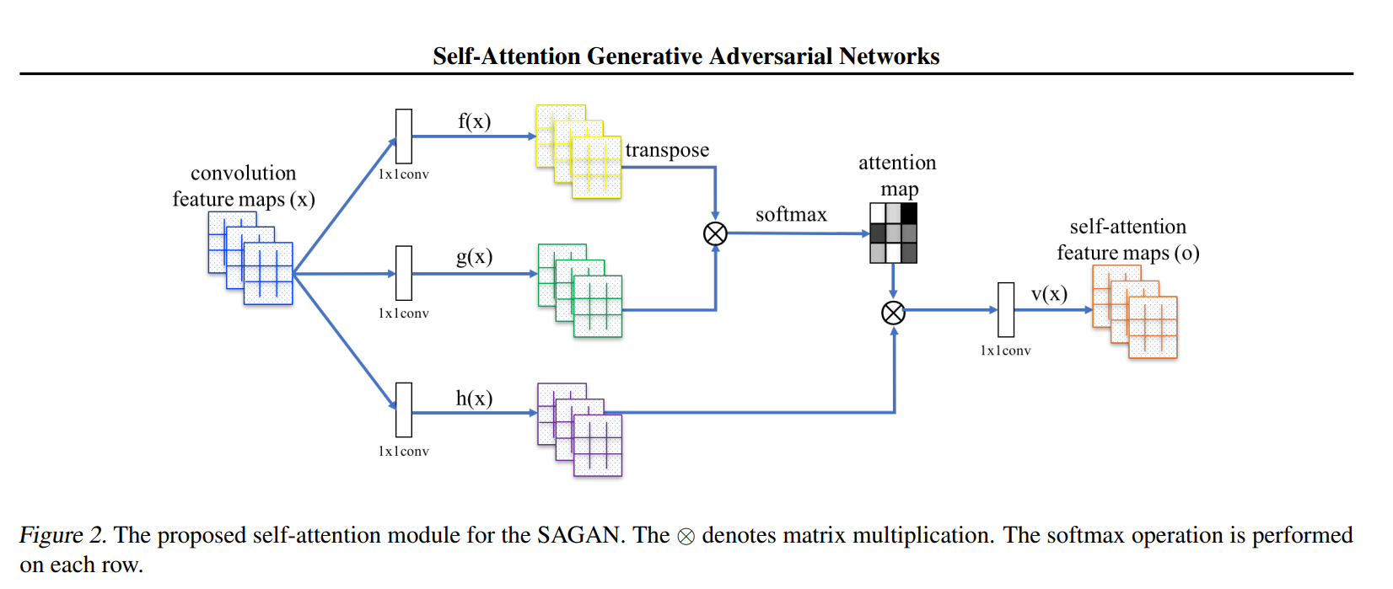
Introducing Attention | Upsampling & Discriminator
Convolutional layers process images locally, meaning they only consider a small neighborhood of pixels at a time. This can make it difficult for the network to capture long-range dependencies, which are important for tasks like image generation.
By incorporating a self-attention layer, the generator in a SAGAN can consider information from all parts of the image at once. The attention mechanism assigns weights to different parts of the image based on their importance for generating the current pixel. The discriminator can check that highly detailed features in distant portions of the image are consistent with each other.

Slide 18
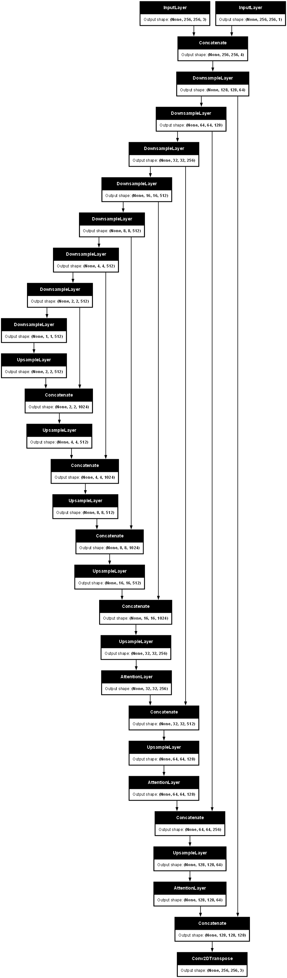
Introducing Attention
ATTENTION BLOCKS
COMPRESSED (1x1x512) REPRESENTATION OF IMAGE (AFTER DOWNSAMPLING)

Slide 19
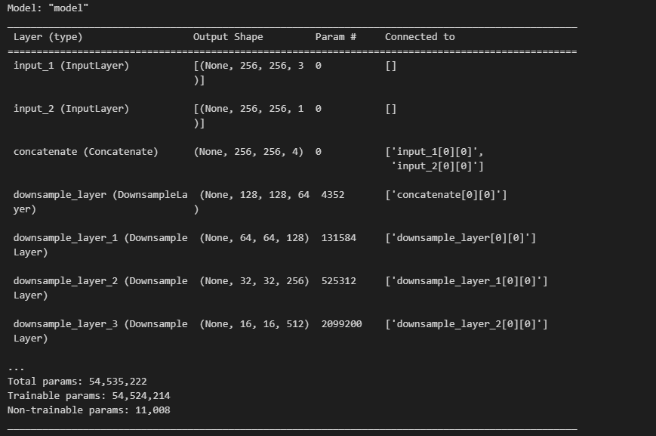
GAN Architecture | Attention + Edge
Same amount of parameters!

Slide 20
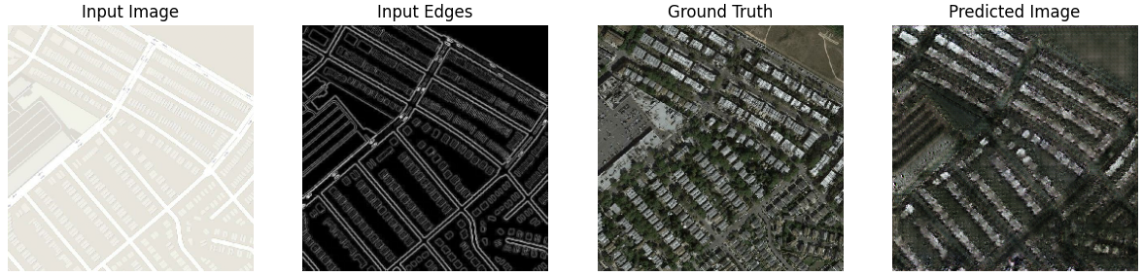
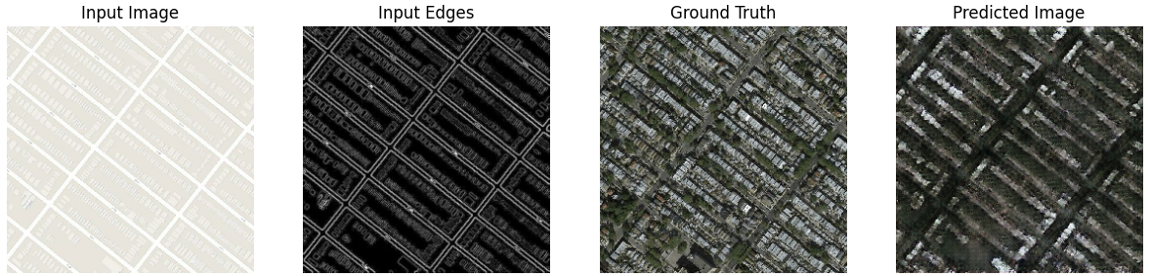
Training – After 40K Steps | Attention + Edge

Slide 21
Conclusions
Task (Overall, for Generator, for Discriminator).
Details of GAN implementation:
Architecture
Generator:
Tanh activation at the last layer
Loss function: weighted sum of L1 loss and gan_loss
Discriminator:
No activation function at the last layer
Loss function: sum of real_loss and generated_loss
Introduction of the Edge Map.
Introduction of the Attention Block.

Slide 22
Sources
Basic GAN architecture:
https://semiengineering.com/knowledge_centers/artificial-intelligence/neural-networks/generative-adversarial-network-gan/
ReLU/Leaky ReLU:
https://paperswithcode.com/method/rrelu
SAGAN paper:
https://arxiv.org/pdf/1805.08318.pdf
https://github.com/heykeetae/Self-Attention-GAN/blob/8714a54ba5027d680190791ba3a6bb08f9c9a129/sagan_models.py#L8

